Slide 1
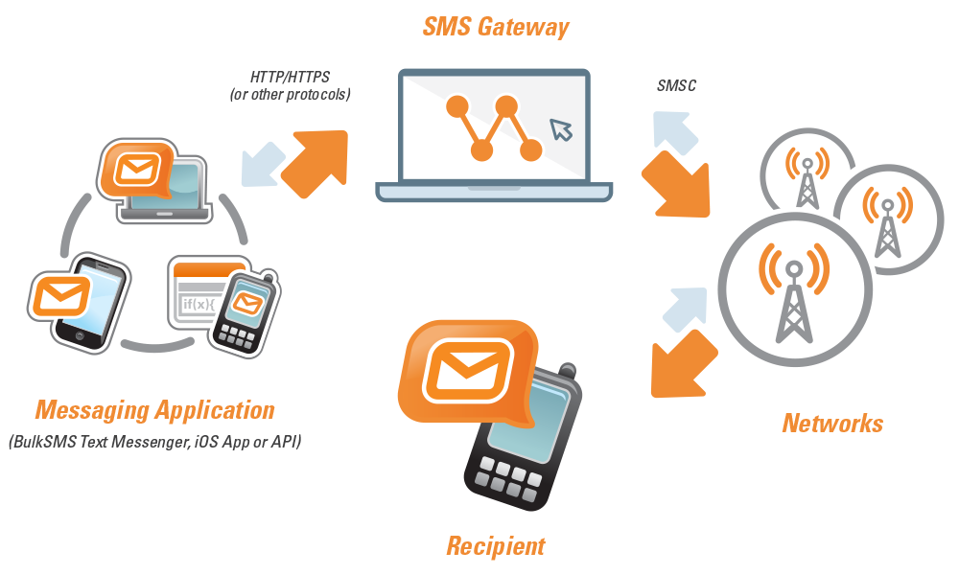
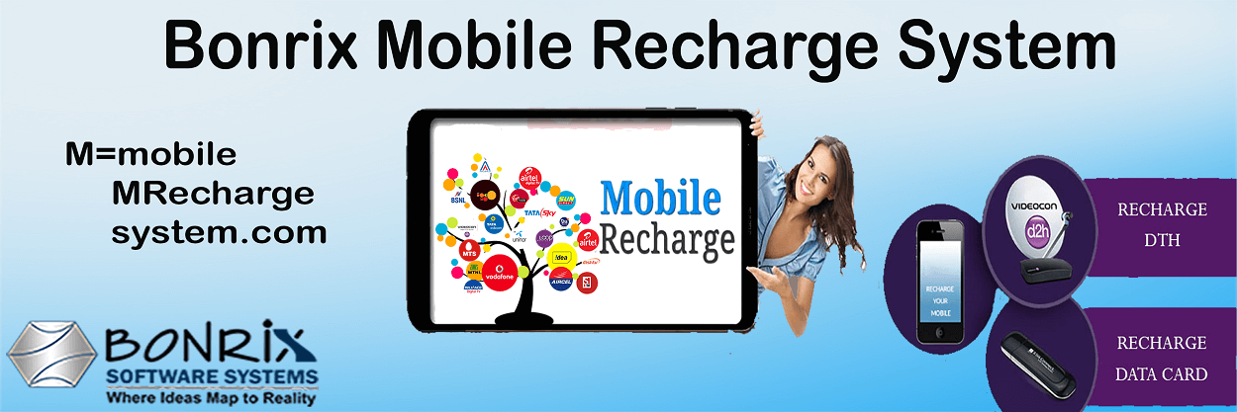




SMS via Mobile: Comprehensive Bulk SMS Solutions
A Bonrix Software Systems Product
Bulk SMS
Mobile Integration
Marketing
Enterprise

Slide 2


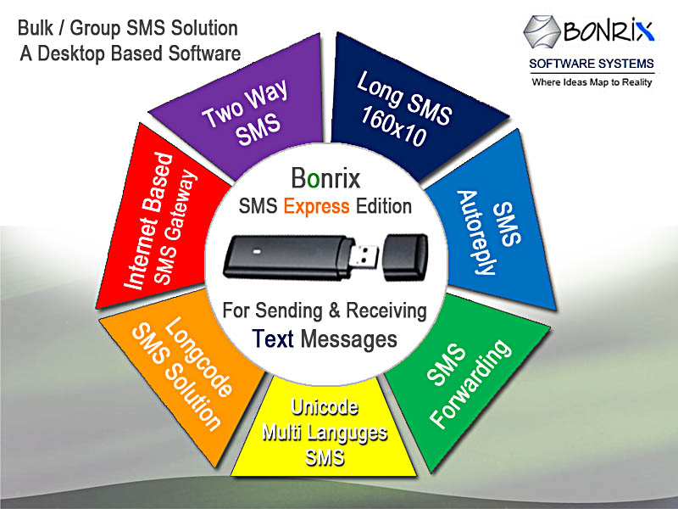





About SMS via Mobile
A product of Bonrix Software Systems, a leading IT solutions provider since 2001
Based in Ahmedabad, Gujarat, India
Specializes in bulk SMS solutions for businesses of all sizes
Compatible with CDMA, 3G, GSM, GPRS, HSDPA Modems and Handsets
Supports almost all Nokia and other modems supporting AT Commands
Two-Way SMS supported for interactive communication
Services include marketing, election campaigns, customer care, team management

Slide 3






Product Offerings
SMS Express Edition
Entry-level bulk SMS solution via SIM card-based system
Advance SMS Express Edition
Enhanced features for growing businesses
Advance SMS Express 20 Port
High-volume SMS solution for larger operations
Professional SMS Express Edition
Premium features for enterprise needs
Bulk SMS Packages
5K, 25K, 50K, 100K SMS bundles for various needs

Slide 4


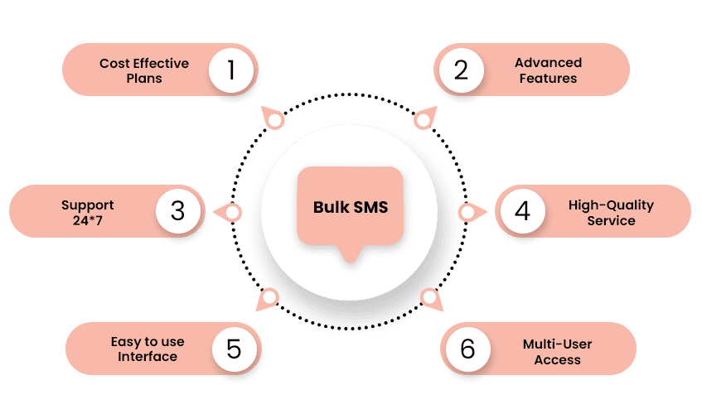






Key Features
Send & Receive SMS
Auto Reply SMS
Phone book management & group SMS
Automated responses
SMS Forwarding
Long SMS Support
Redirect messages
Extended messages
Two-way SMS
Multi-language SMS
Interactive communication
Unicode support
Internet Gateway
HTTP API Integration
Web-based SMS sending
Seamless connectivity

Slide 5


Pricing Options
SMS Express Edition
Advance SMS Express
₹6,000.00
₹12,000.00
Advance SMS 20 Port
Professional SMS
₹18,000.00
₹30,000.00
Bulk SMS Packages
More Bulk Options
5K: ₹1,000 | 25K: ₹4,000
50K: ₹7,000 | 100K: ₹12,000
Note: Prices are for software licenses. SMS credits may have additional costs based on service provider.

Slide 6


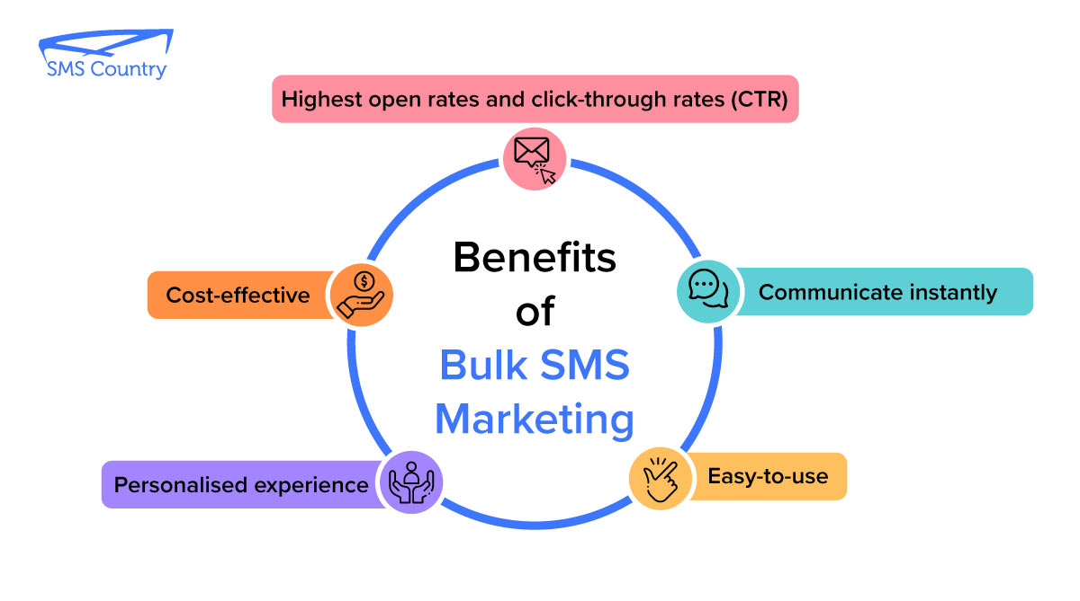





Benefits of Bulk SMS
Cost-Effective
Fast Delivery
Least cost solution for reaching targeted clients
Reach people in the shortest time
High Readability
Precise Communication
Highest probability of being read
Small and focused messages for better impact
No Receiver Cost
Wide Reach
Doesn't consume receiver's account balance
Compatible with all major networks in India
Versatile Applications
Marketing, campaigns, customer care & more

Slide 7




Contact Us
Address
Websites
A-801, Samudra Complex Near Classik Gold Hotel Off C.G.Road, Ahmedabad Gujarat - 380009, India
smsviamobile.com bonrix.net bonrix.in bonrix.co.in
Phone
+91-9426045500 +91-9429045500
Email
info@bonrix.net bonrix@gmail.com sales.bonrix@gmail.com

